Slide 1
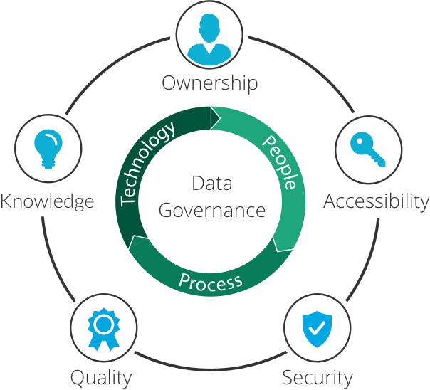
Data Governance
The Fundamentals

Slide 2
Do the following Udemy Course
https://deloittedevelopment.udemy.com/course/data-governance-fundamentals/learn/lecture/22189488#overview

Slide 3
Questions?

